Slide 1

Attention mechanism
A lecture by Maneesha Rajapaksha

Slide 2
What Attention Actually Does
Self-attention takes static embeddings and turns them into contextual embeddings.
Before attention:
Each word has a fixed meaning:
“bank” → same vector everywhere
After attention:
The embedding changes based on context:
“river bank” → nature meaning
“money bank” → financial meaning
So attention = context-aware transformation

Slide 3
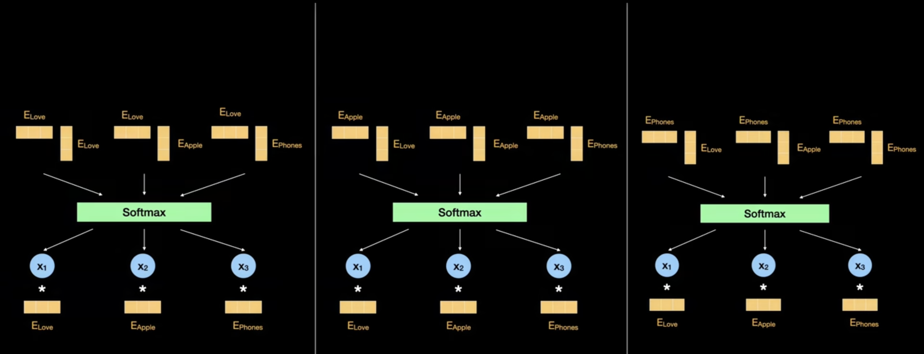
Love apple juice

Slide 4
Setup & Notation
Input X → shape: [T × d_model]
Example: T=5 tokens, d_model=8
X = [
[0.2, 0.9, 0.1, -0.3, 0.7, 0.4, -0.1, 0.5], ← token 0: "The"
[0.8, -0.2, 0.6, 0.4, -0.5, 0.3, 0.9, -0.1], ← token 1: "cat"
[0.1, 0.7, -0.4, 0.8, 0.2, -0.6, 0.3, 0.5], ← token 2: "sat"
...
]
For multi-head attention with H heads:
Symbol | Meaning | Example Value
d_model | Input/output embedding dim | 512
H | Number of heads | 8
d_k | Key/Query dim per head = d_model/H | 64
d_v | Value dim per head = d_model/H | 64
T | Sequence length | varies

Slide 5
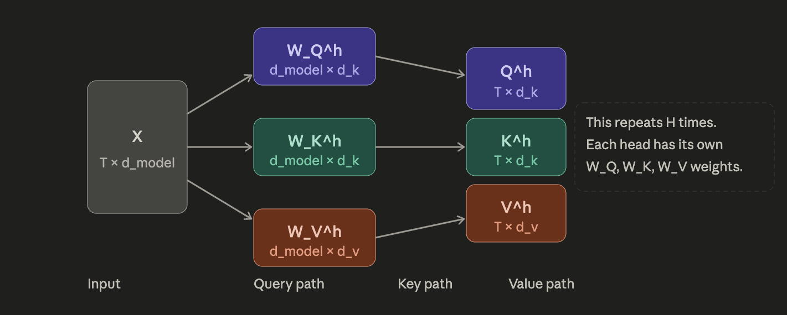
Step 1 — The Q, K, V Projections
Each head h has its own three learned weight matrices:
W_Q^h ∈ ℝ^(d_model × d_k)
W_K^h ∈ ℝ^(d_model × d_k)
W_V^h ∈ ℝ^(d_model × d_v)
For each head, we project the input X into three matrices:
Q^h = X · W_Q^h shape: [T × d_k] ← "What am I looking for?"
K^h = X · W_K^h shape: [T × d_k] ← "What do I contain?"
V^h = X · W_V^h shape: [T × d_v] ← "What do I broadcast if attended to?"

Slide 6
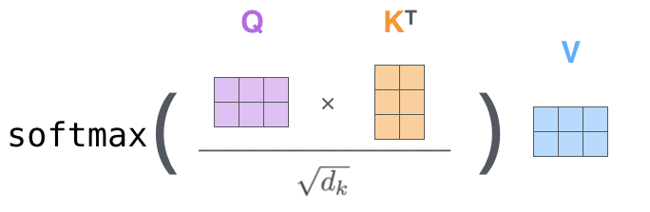
Step 2 — Scaled Dot-Product Attention (per head)
Compute raw attention scores:
scores = Q^h · (K^h)ᵀ shape: [T × T]
Each entry scores[i][j] = dot product of query_i and key_j
= "how much does token i attend to token j?"
Scale by √d_k (prevents gradient vanishing):
scaled_scores = scores / √d_k
Apply Softmax (row-wise → each row sums to 1):
A^h = softmax(scaled_scores) shape: [T × T]
A^h[i][j] = probability that token i attends to token j
Weighted sum of Values:
head^h = A^h · V^h shape: [T × d_v]
Output for token i = Σ_j A^h[i][j] · V^h[j]

Slide 7
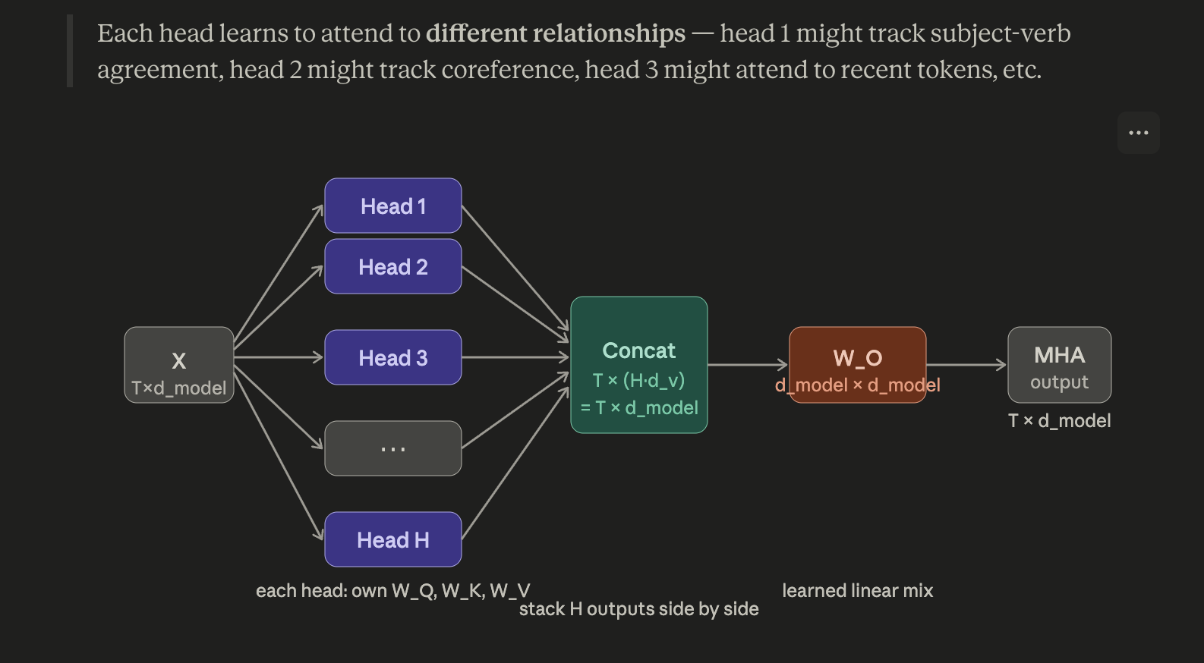

Slide 8
Masking (Decoder-Only Models like GPT)
In a decoder (autoregressive generation), token i must not attend to future tokens j > i. We achieve this with a causal mask applied before softmax:
# Causal mask: upper triangle = -∞
mask = torch.triu(torch.full((T, T), float('-inf')), diagonal=1)
scaled_scores = scaled_scores + mask # -∞ → exp(-∞) = 0 after softmax
# Result: lower-triangular attention matrix
A[i][j] = 0 if j > i (future tokens are invisible)
Attention matrix for 4-token sequence (GPT-style):
tok0 tok1 tok2 tok3
tok0 [ 1.00 0 0 0 ] ← can only see itself
tok1 [ 0.38 0.62 0 0 ]
tok2 [ 0.21 0.35 0.44 0 ]
tok3 [ 0.15 0.26 0.22 0.37] ← sees all previous + itself

Slide 9
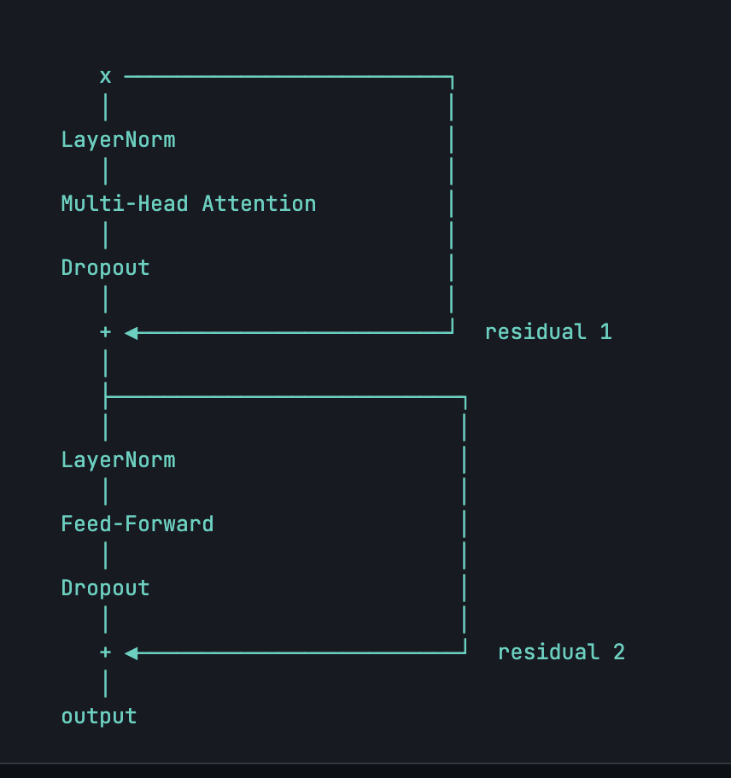
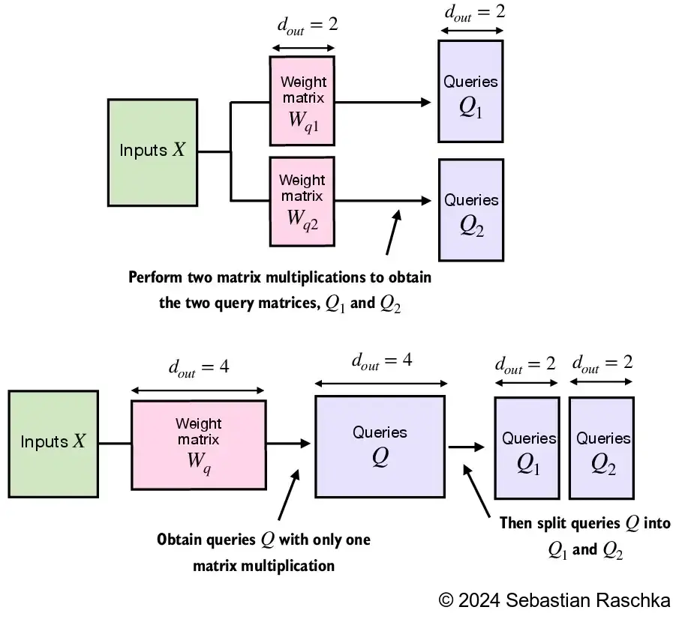
One transformer block combines everything: LayerNorm → Multi-Head Attention → Residual → LayerNorm → FFN → Residual. GPT-2 uses Pre-Norm (LN before sublayer).

Slide 10
class MultiHeadAttention(nn.Module):
def __init__(self, d_model, n_heads, dropout=0.1):
super().__init__()
assert d_model % n_heads == 0
self.n_heads = n_heads
self.head_dim = d_model // n_heads # d_k
# H separate sets of [d_model → d_k] projections
self.W_q = nn.ModuleList([nn.Linear(d_model, self.head_dim, bias=False) for _ in range(n_heads)])
self.W_k = nn.ModuleList([nn.Linear(d_model, self.head_dim, bias=False) for _ in range(n_heads)])
self.W_v = nn.ModuleList([nn.Linear(d_model, self.head_dim, bias=False) for _ in range(n_heads)])
self.out_proj = nn.Linear(d_model, d_model, bias=False)
self.dropout = nn.Dropout(dropout)
def forward(self, x):
B, T, C = x.shape
head_outputs = []
for h in range(self.n_heads):
# each head has its own independent projection to d_k
Q_h = self.W_q[h](x) # [B, T, d_k]
K_h = self.W_k[h](x) # [B, T, d_k]
V_h = self.W_v[h](x) # [B, T, d_k]
# scaled dot-product attention
scores = (Q_h @ K_h.transpose(-2, -1)) / (self.head_dim ** 0.5) # [B, T, T]
mask = torch.triu(torch.ones(T, T, device=x.device), diagonal=1).bool()
scores = scores.masked_fill(mask, float('-inf'))
weights = F.softmax(scores, dim=-1) # [B, T, T]
weights = self.dropout(weights)
out_h = weights @ V_h # [B, T, d_k]
head_outputs.append(out_h)
# explicit concatenation of all head outputs along last dim
out = torch.cat(head_outputs, dim=-1) # [B, T, n_heads*d_k] = [B, T, d_model]
return self.out_proj(out)

Slide 11
class MultiHeadAttention(nn.Module):
def __init__(self, d_model, n_heads, dropout=0.1):
super().__init__()
assert d_model % n_heads == 0
self.n_heads = n_heads
self.head_dim = d_model // n_heads
# fused: equivalent to H separate [d_model, d_k] matrices stacked
self.W_q = nn.Linear(d_model, d_model, bias=False)
self.W_k = nn.Linear(d_model, d_model, bias=False)
self.W_v = nn.Linear(d_model, d_model, bias=False)
self.out_proj = nn.Linear(d_model, d_model, bias=False)
self.dropout = nn.Dropout(dropout)
def forward(self, x):
B, T, C = x.shape
# one big matmul instead of H small ones
Q = self.W_q(x) # [B, T, d_model]
K = self.W_k(x) # [B, T, d_model]
V = self.W_v(x) # [B, T, d_model]
# unstack H heads: [B, T, d_model] → [B, n_heads, T, head_dim]
Q = Q.reshape(B, T, self.n_heads, self.head_dim).transpose(1, 2)
K = K.reshape(B, T, self.n_heads, self.head_dim).transpose(1, 2)
V = V.reshape(B, T, self.n_heads, self.head_dim).transpose(1, 2)
# scaled dot-product attention across all heads simultaneously
scores = (Q @ K.transpose(-2, -1)) / (self.head_dim ** 0.5) # [B, n_heads, T, T]
mask = torch.triu(torch.ones(T, T, device=x.device), diagonal=1).bool()
scores = scores.masked_fill(mask, float('-inf'))
weights = F.softmax(scores, dim=-1) # [B, n_heads, T, T]
weights = self.dropout(weights)
out = weights @ V # [B, n_heads, T, head_dim]
# concat heads: [B, n_heads, T, head_dim] → [B, T, d_model]
out = out.transpose(1, 2).reshape(B, T, C)
return self.out_proj(out)

Slide 12
Feedfoward
After attention, each position is processed independently through a 2-layer MLP with a GELU activation. The inner dimension is typically 4× d_model.
class FeedForward(nn.Module):
def __init__(self,d_model,dropout=0.1):
super().__init__()
self.net=nn.Sequential(
nn.Linear(d_model,4*d_model),
nn.GELU(),
nn.Linear(4*d_model,d_model),
nn.Dropout(dropout),
)
def forward(self,x):
return self.net(x)

Slide 13
Transformer block
class TransformerBlock(nn.Module):
def __init__(self,d_model,n_heads,dropout=0.1):
super().__init__()
self.ln1=nn.LayerNorm(d_model)
self.attn=MultiHeadAttention(d_model,n_heads,dropout)
self.ln2=nn.LayerNorm(d_model)
self.ffn=FeedForward(d_model,dropout)
def forward(self,x):
x=x+self.attn(self.ln1(x))
x=x+self.ffn(self.ln2(x))
return x

Slide 14
